Slide 1
Quick sort
Mohamed Tamer <220621>

Slide 2
what is quick sort algorithm
QuickSort is a sorting algorithm that uses a divide-and-conquer strategy to sort an array.
It does so by selecting a pivot element and then sorting values larger than it on one side and smaller to the other side, and then it repeats those steps until the array is sorted.
It is useful for sorting big data sets.

Slide 3
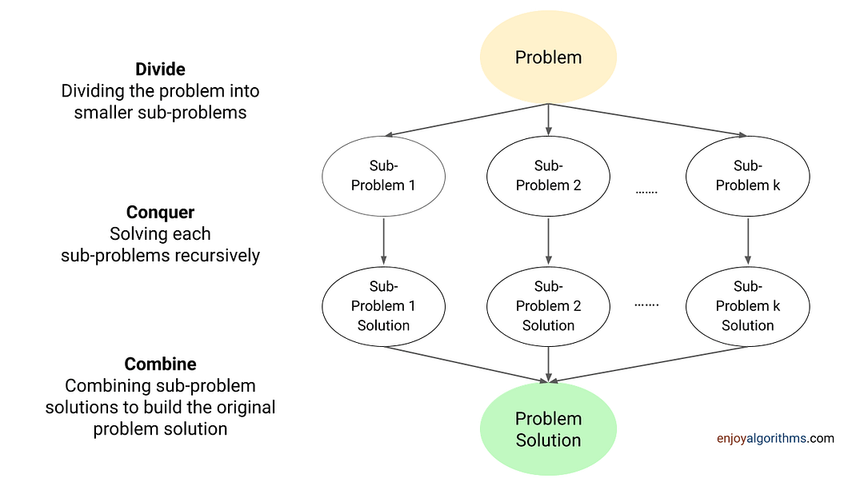

Slide 4
How Quicksort works ?
Quick Sort is a widely used sorting algorithm that follows the divide-and-conquer approach.
It's known for its efficiency in sorting large datasets and is commonly used in various applications due to its good average-case performance.
Quick Sort is used in scenarios where average-case performance is important.

Slide 5
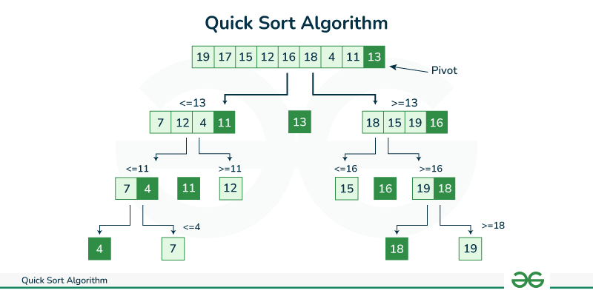

Slide 6
def quicksort(arr, low, high): if low < high: pi = partition(arr, low, high) quicksort(arr, low, pi - 1) quicksort(arr, pi + 1, high) | def partition(arr, low, high): pivot = arr[high] i = low - 1 for j in range(low, high): if arr[j] <= pivot: i = i + 1 arr[i], arr[j] = arr[j], arr[i] arr[i + 1], arr[high] = arr[high], arr[i + 1] return i + 1 If word == "__main__": arr = [10, 7, 8, 9, 1, 5] print("not sort", arr) quicksort(arr, 0, len(arr) - 1) print("sort:", arr)

Slide 7
Thank you for listening

